Slide 1


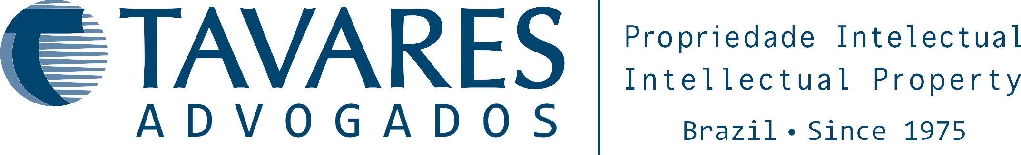
13th Annual International Seminar of MarkPatent.ORG on Intellectual Property Rights
“Recent developments in analysis in prosecution in chemistry, pharmacy and biotechnology in Brazil”
Fábio Graça Sant’Ana
IP-Litigator
February, 2018

Slide 2

Summary
Some facts about Brazil
Recent news from BPTO
Patent Applications Statistics
Possibilities to expedite the examination
Recent – New Guidelines for pharmaceutical and chemical patent applications
Recent Debates
Brazilian legal system
“Infringement” before Grant
Enforcement

Slide 3
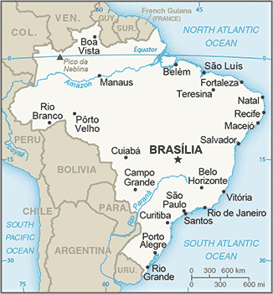
Some facts about Brazil
Population – 206.1 million
Surface – 8,515,767 Km2
Inflation – 8,74%
GDP per capita – US$ 8,726.90
Unemployment rate – 11.27%

Slide 4
Recent news from BPTO
During 2017 the backlog reduced. The drop was 7.6% in patents; 14.9% in trademarks and 26% in industrial designs
There was an increase of approximately 25% in the number of patent grants; among the 20 countries with most patent grants;
As of January 16, 2018 a pilot program for pre-examination opinions – chance to amend patent application according to the Patent Offices;

Slide 5
Recent news from BPTO
BPTO has launched PPH Pilot Program with SIPO, EPO and USPTO.
BPTO published on January 2, 2018 the new Guidelines for the Examination of Patent Applications related to chemical inventions.
Currently BPTO and UKIPO are discussing a possible collaboration agreement.

Slide 6
Patent Applications Statistics

Slide 7
Possibilities to expedite the examination
Infringed claims
Patents needed for receiving financial resources
Senior Status of Applicant or illness
Green Technology
Oil and Gas (PPH-BPTO/USPTO) until January 11, 2018
IT and Telecommunications Technologies (PPH-BPTO/JPT) until April 1, 2019
PPH Pilot Program with EPO (Chemical).
PPH Pilot Program with SIPO (IT, packaging, measuring and chemical) – up to 200 applications can be accepted and USPTO.
Expedite through courts may also be an option

Slide 8
New Guidelines for Patent Applications
Pharmaceutical inventions (Settlement between BPTO/ANVISA)
Chemical inventions
Pilot program for issuance of pre-examination technical opinions
Computer implemented inventions

Slide 9
Settlement between BPTO and ANIVSA
PRIOR CONSENT (former procedure)
Article 229-C - The grant of patents to pharmaceutical products and processes will depend on the previous approval of the National Health Surveillance Agency – ANVISA, which should examine the subject matter of the application in light of the public health. (…)
It is considered that the application is contrary to public health when: (…)
The application …is of interest to drug policy or pharmaceutical assistance under the Unified Health System – SUS and does not meet the patentability requirements…

Slide 10
Settlement between BPTO and ANIVSA
PRIOR CONSENT (new procedure)
On April 12, 2017, BPTO and ANVISA signed the Joint Ordinance #1/2017, which regulates the procedures for the application of Article 229-C of Brazilian IP Law. This Joint Ordinance will come into force on June 12, 2017.
ANVISA’s new attribution is restrict to analyze whether a subject matter of a patent application represents risk to health only.
BPTO’s attribution is to analyze patentability requirements of the subject matter.

Slide 11
Brazilian Legal System
Legal procedures are slow
- Backlog (many cases vs. small staff)
→ Fast preliminary injunction!!!
Judicial system with three instances

Slide 12
Court Hierarchy in Brazil
1st Instance:
  Federal Courts
  State Courts
2nd Instance (appeal)
3rd Instance Superior Courts
10+ YEARS

Slide 13
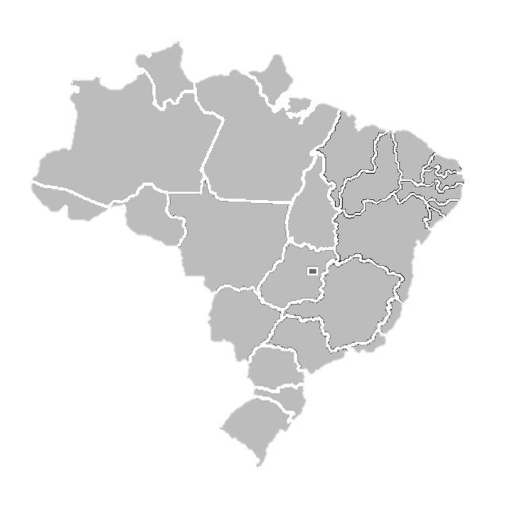
Federal Courts
Exclusive for suits against the Federal Government
  BPTO
  ANVISA
Courts specialized in IP only
  Rio de Janeiro
NOTE: 5 year maximum term to file suit challenging administrative decisions

Slide 14
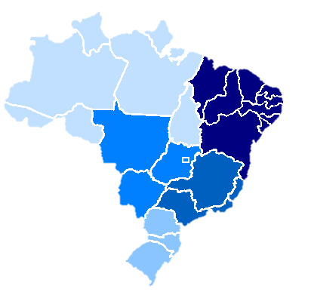
State Courts
Serves for any civil and criminal actions
Federal entities not involved (BPTO)
Courts specialized in IP only
  Rio de Janeiro - fastest
  São Paulo - slowest
NOTE: Venue is based on Defendant's or Infringement’s location

Slide 15
Court Hierarchy in Brazil
1st Instance:
  State Courts
  Federal Courts
2nd Instance (appeal)
  State Courts
  Federal Courts
  Panel of 3 Judges
3rd Instance Superior Courts
Superior Court of Justice – Violation of Federal Laws
Federal Supreme Court - Violation of Constitution
Suits may be appealed up to the Superior Courts!
10+ YEARS

Slide 16
“Infringement” before Grant?
Restricted – expectation of rights
Registered Warning letters
- Request to expedite examination (BPTO - 2 year delay)
- showing evidence
- warning letter
Court actions only based on unfair competition
- Need for strong evidence

Slide 17
Criminal vs Civil suit
Search & seizure
Samples
Criminal
Criminal Complaint
Arrest of Infringers
Penalties applied
Suit
Preliminary Injunction
*Technical report advised
Trial
Damages collected
Civil
Search & seizure
Notes:
No caso de uma infração temos duas opções a seguir ou mesmo optar pelas duas
Se optar pela processo criminal, o processo civil só poderá se iniciado após o termino deste
Em geral os processos criminais está relacionados a pirataria, por exemplo, cópias de produtos que estão sendo vendidos localmente, ou que foram importados clandestinos. Seria legal falar de um caso, será que falarmos da Lamborguini, vão perguntar sobre a solução final?
Explicar o Fluxo

Slide 18
Thank you very much for your time
If you have any questions, please don’t hesitate to contact us at:
www.tavaresoffice.com.br
fabio.graca@tavaresoffice.com.br
Tel.: +55 21 2216-6350

